Slide 1
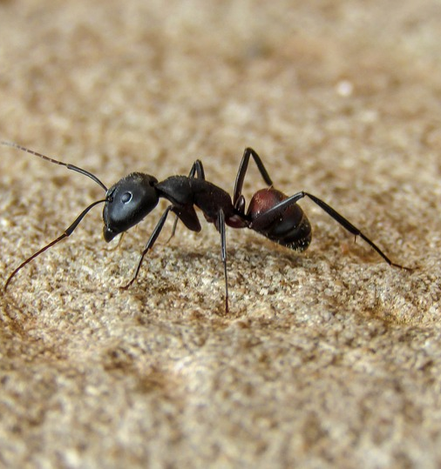

Back to home in desert
Paper of R. Wehner

Slide 2
Paper of R. Wehner

